Slide 1
Collaborative for Neighborhood Transformation
ASSET MAPPING DATABASE TRAINING

Slide 2
Getting To The Database

Slide 3
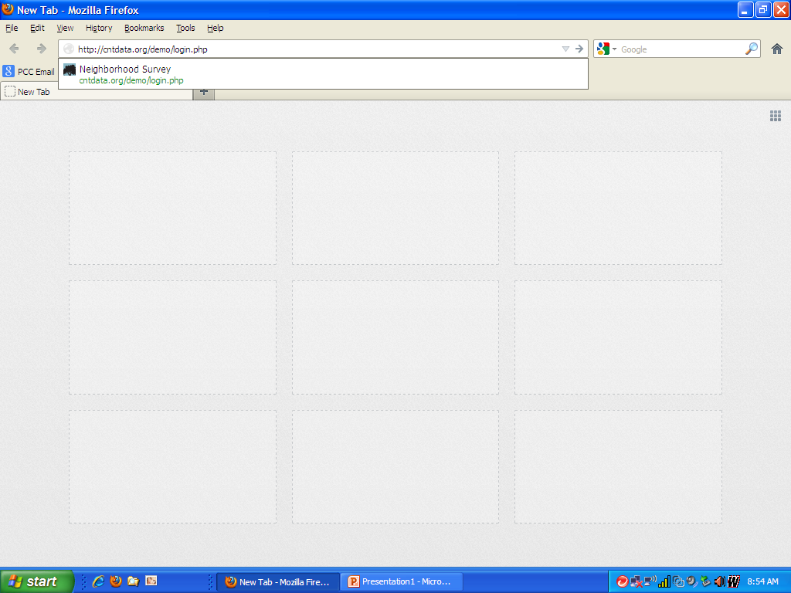
Enter URL

Slide 4
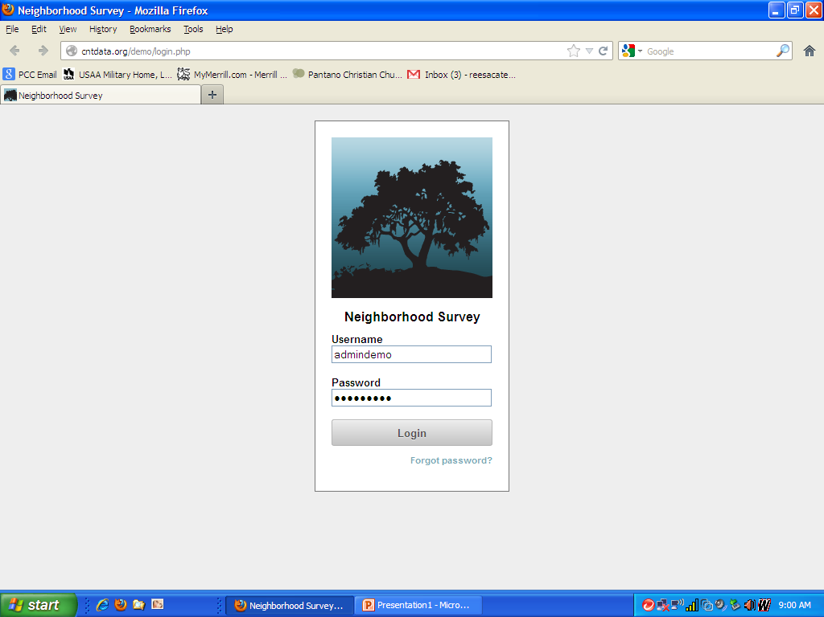
Enter User Name
Enter Password
Click Login

Slide 5
Setting Up Your Neighborhood(s)

Slide 6
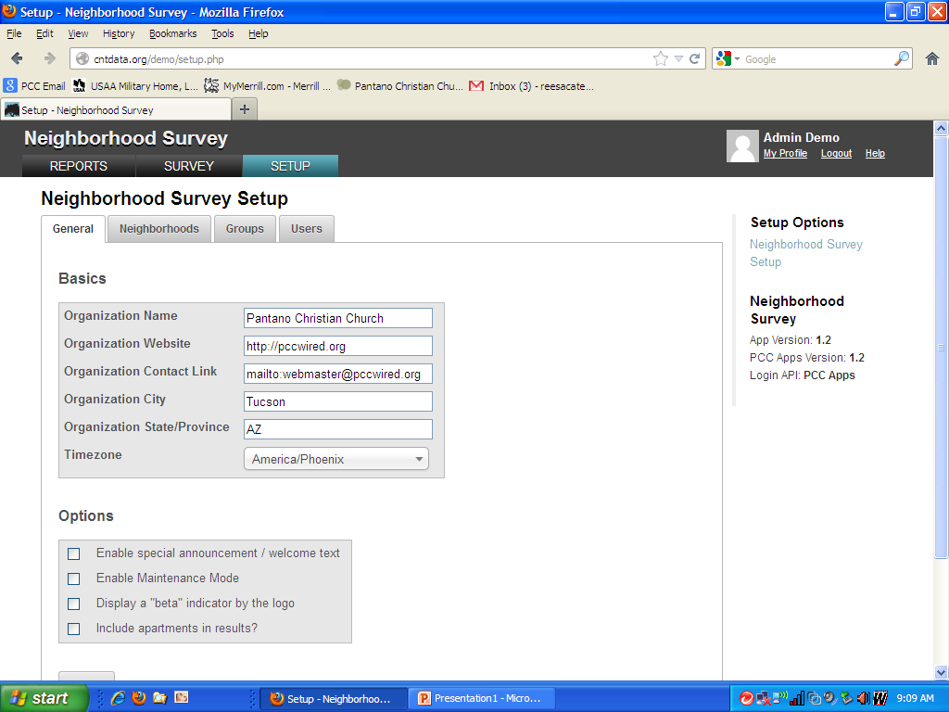
Currently Administered
By PCC

Slide 7
Click On Neighborhoods

Slide 8
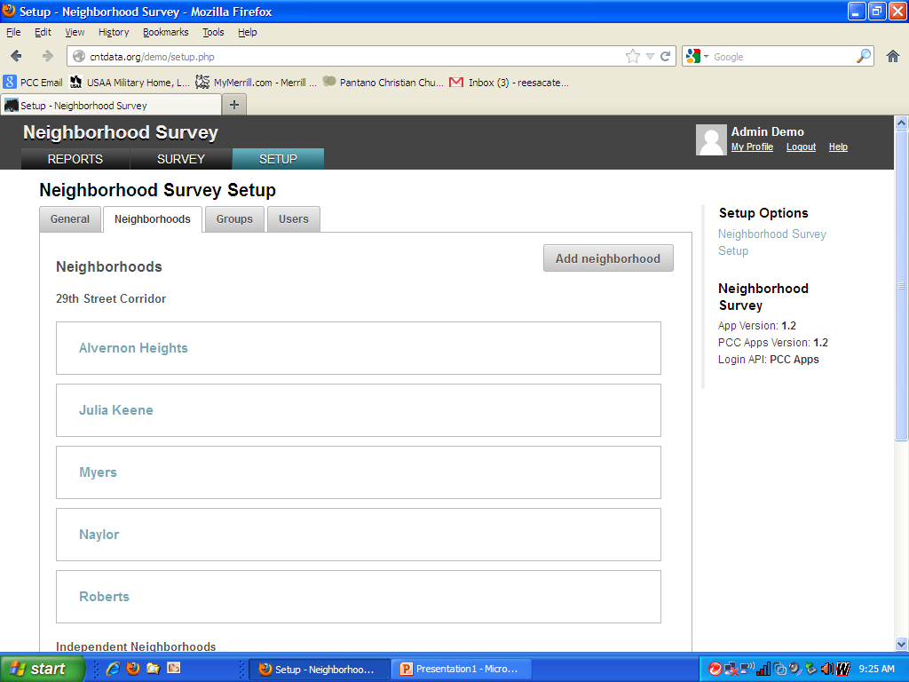
Click On Add neighborhood

Slide 9
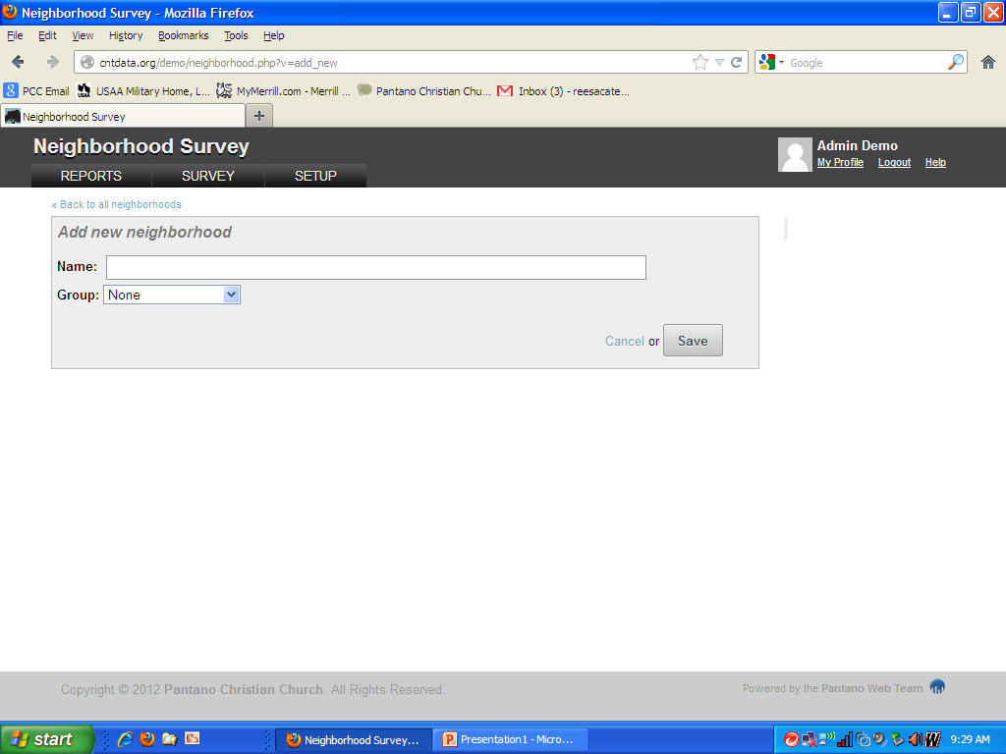
Used When A Church
Is Serving Multiple
Neighborhoods That Are
Contiguous or Are a Coalition
Enter Neighborhood Name

Slide 10
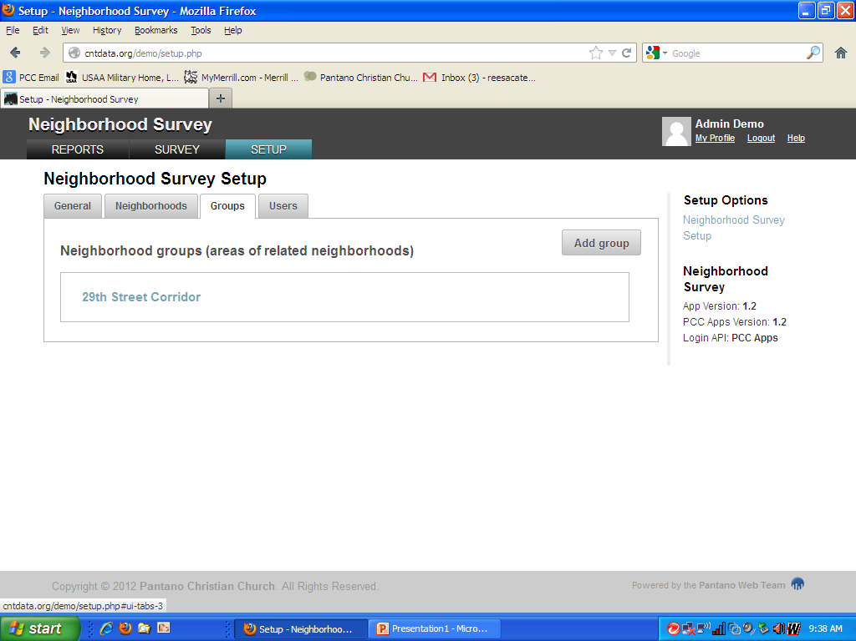
An Example of Groups Where Data can
Is Integrated From Multiple Neighborhoods

Slide 11
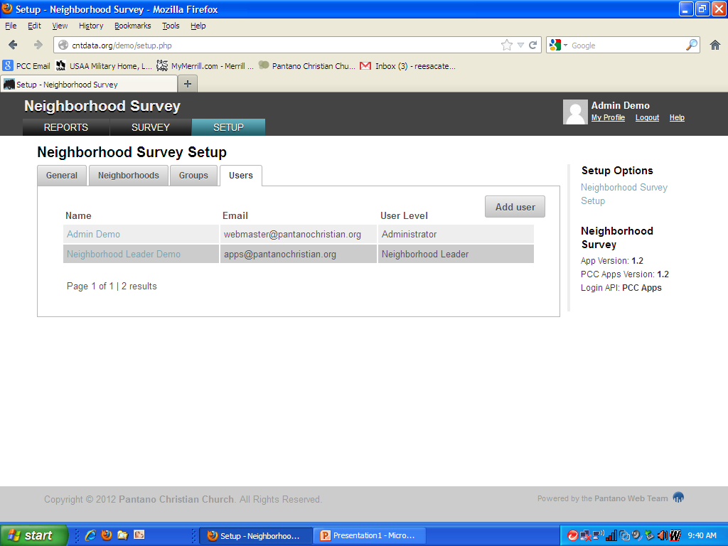
Click on Users

Slide 12
Click On Add User

Slide 13
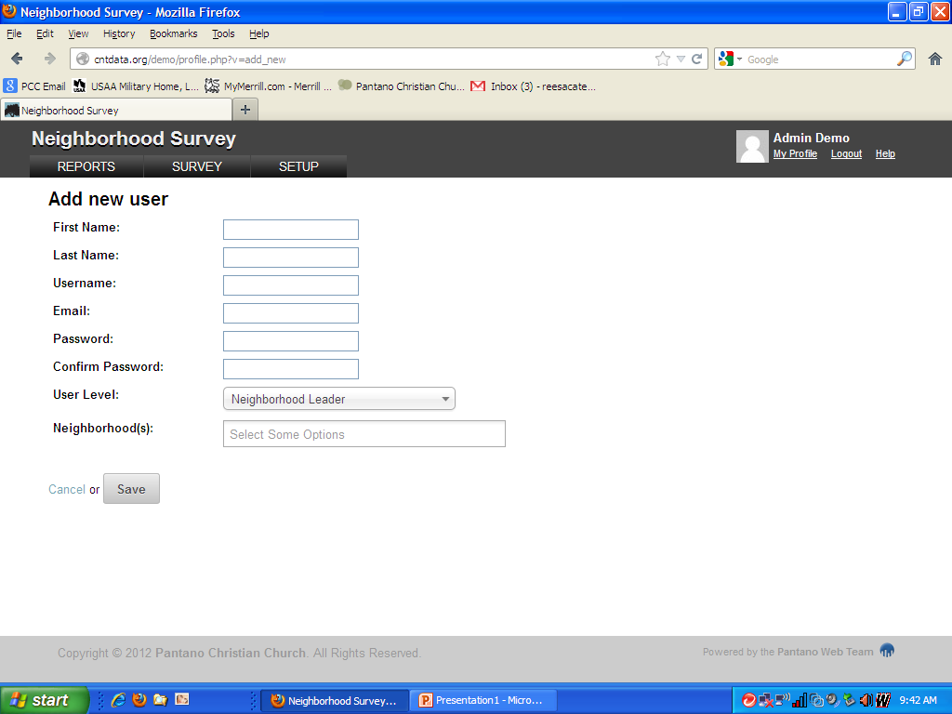
Fill In Data

Slide 14
Click On Drop Down
For User Level

Slide 15
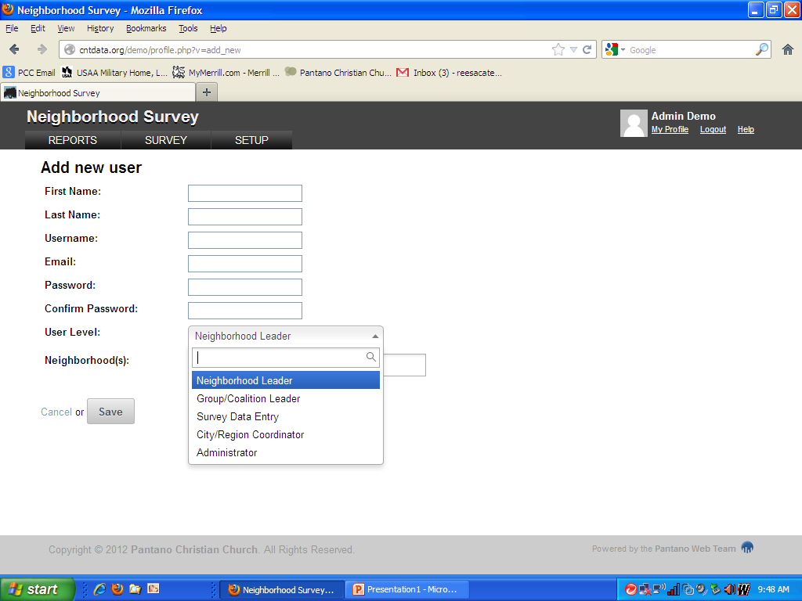
Choose A Level

Slide 16
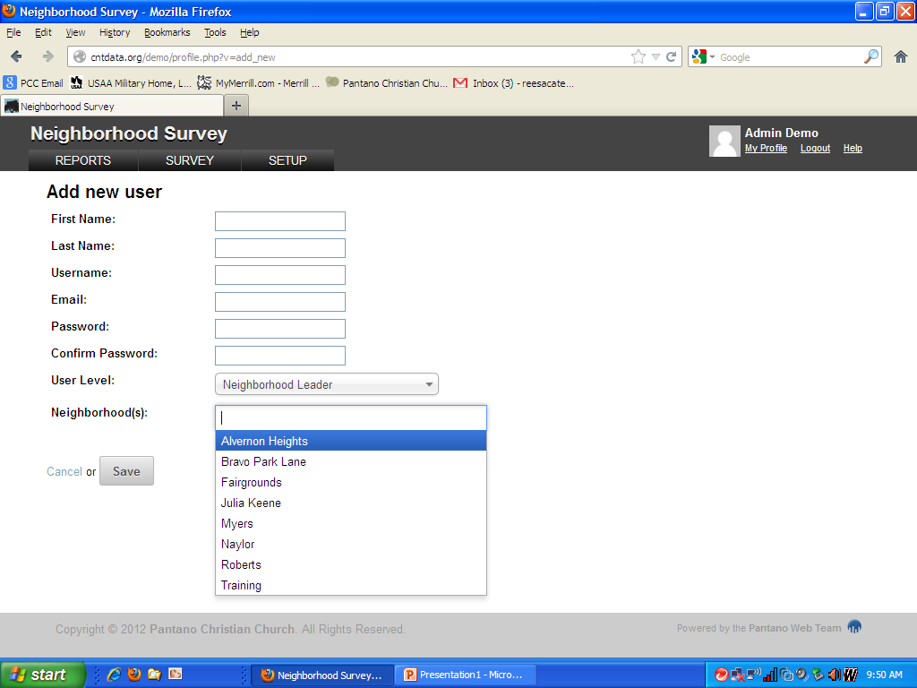
Choose a Neighborhood

Slide 17
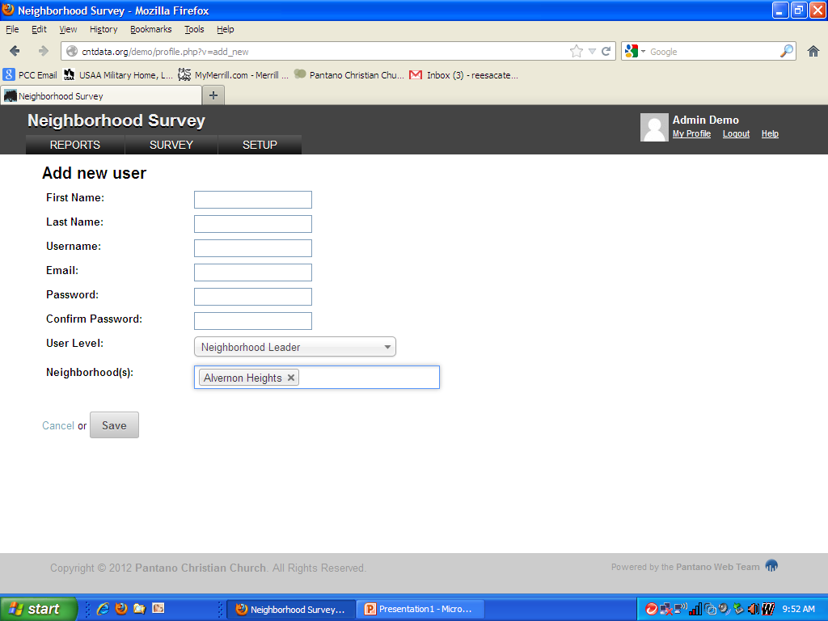
Click Save

Slide 18
Entering Survey Data

Slide 19
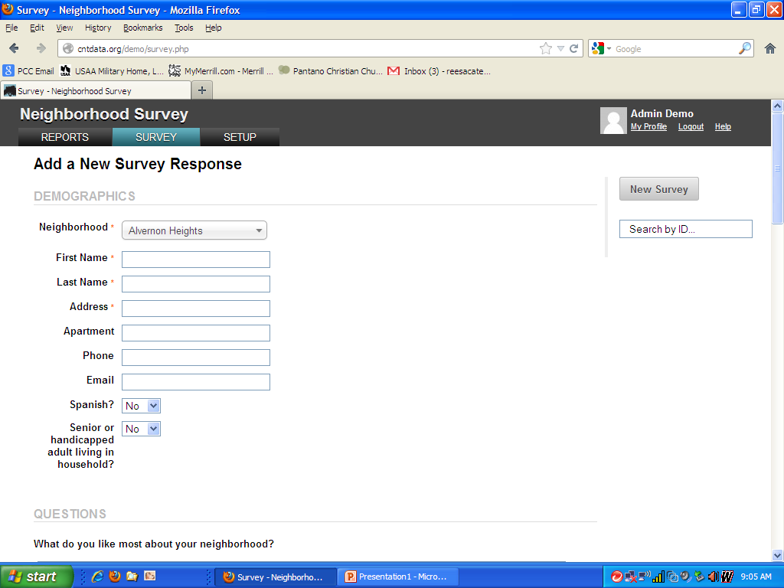

Slide 20
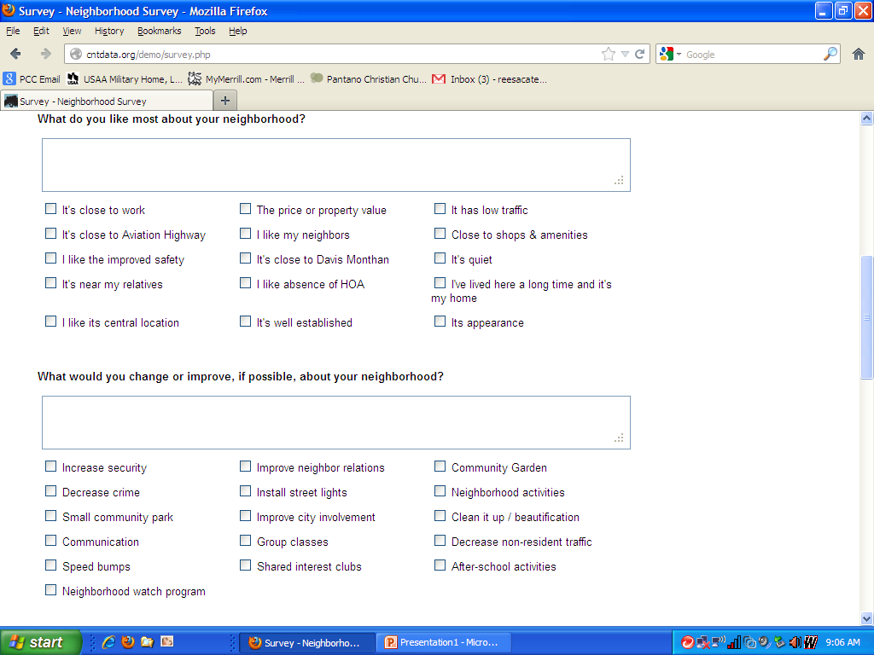

Slide 21
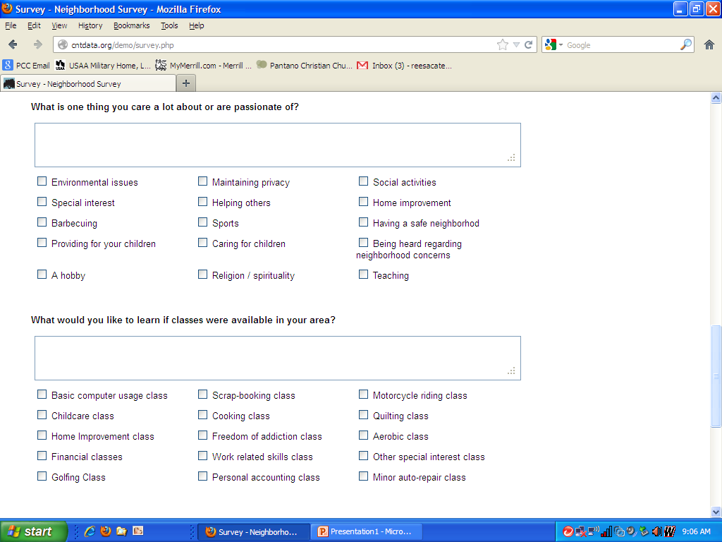

Slide 22
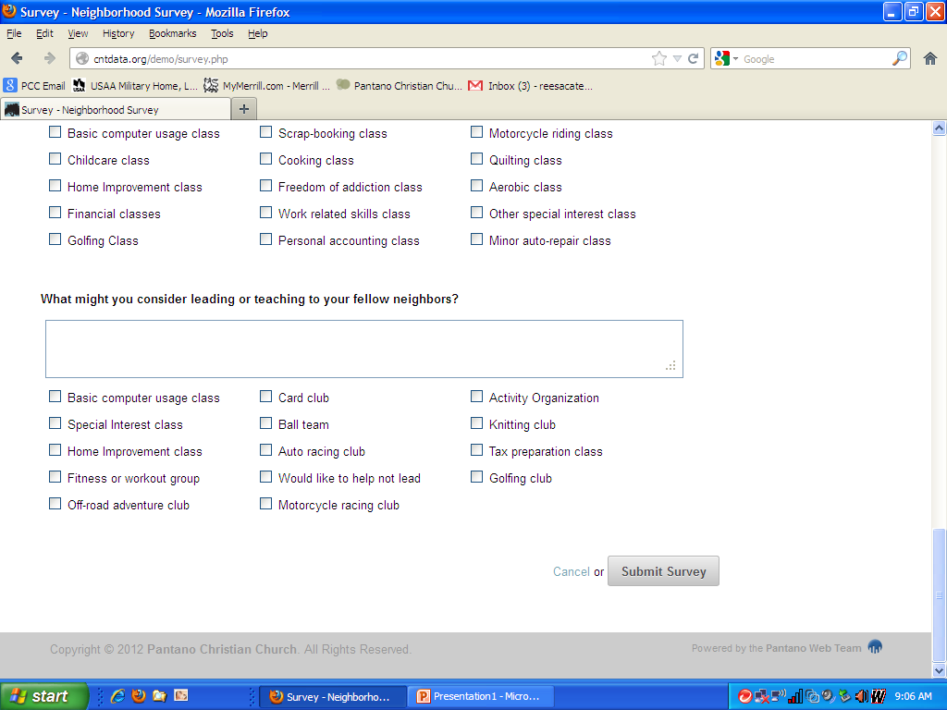
Enter All The Information
And Click Submit Survey

Slide 23
Using The Database

Slide 24
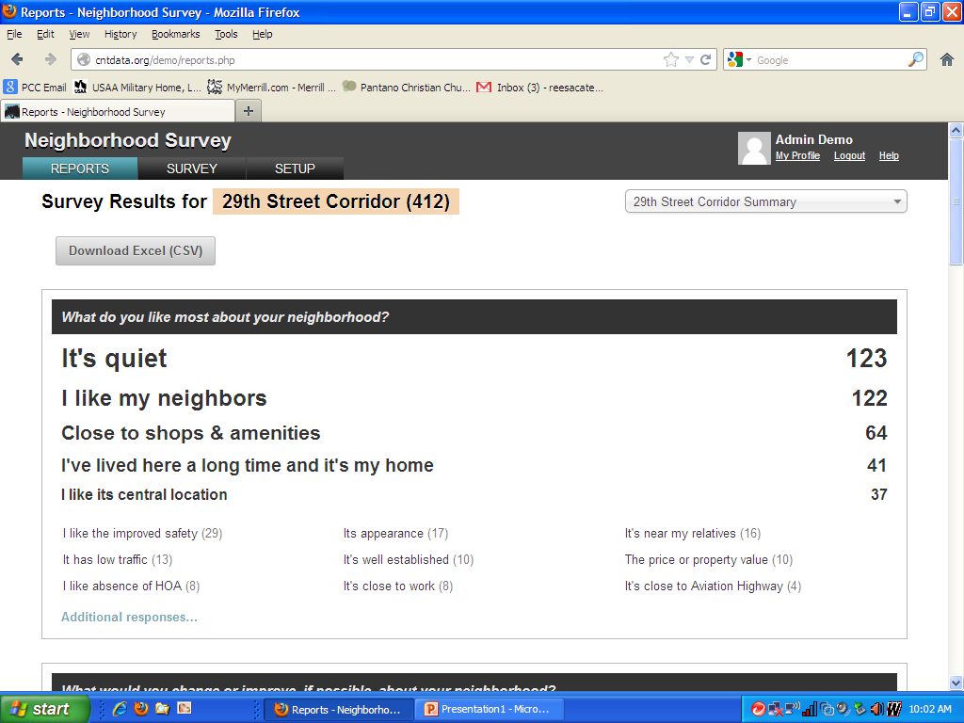
Click On Reports

Slide 25
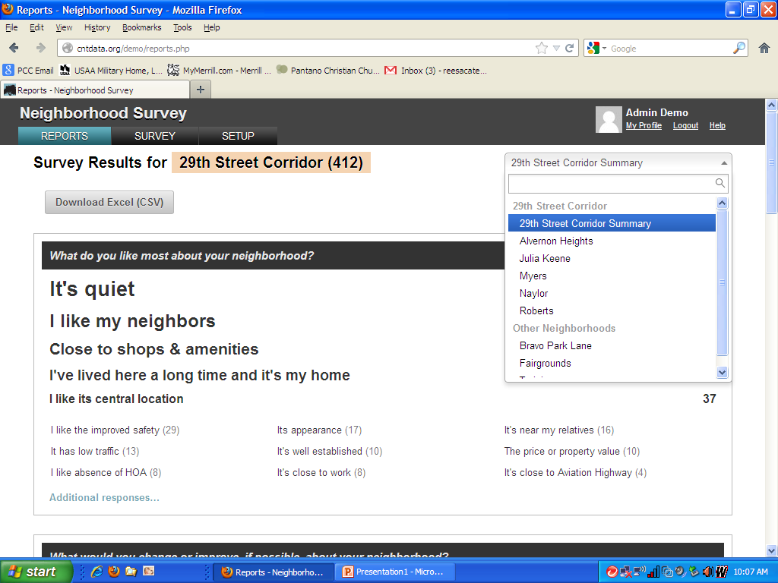
Click On Drop Down And
Choose Neighborhood

Slide 26
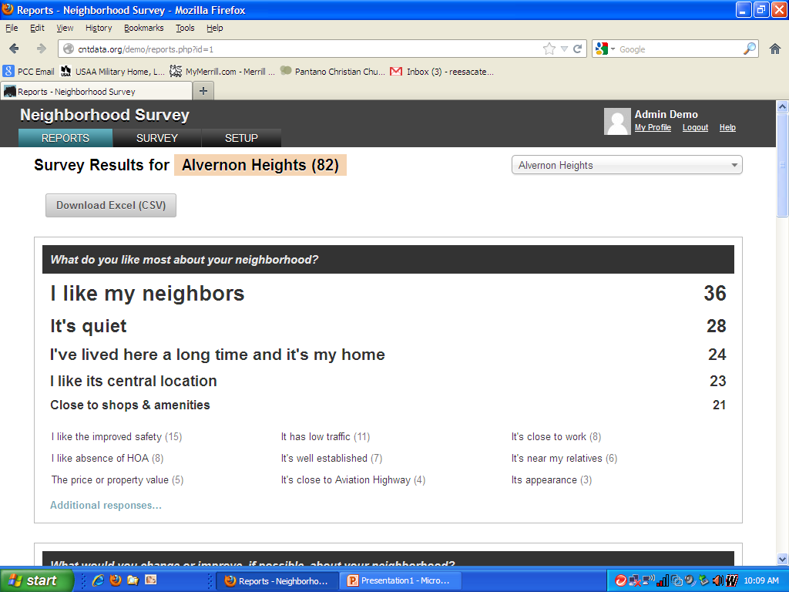

Slide 27
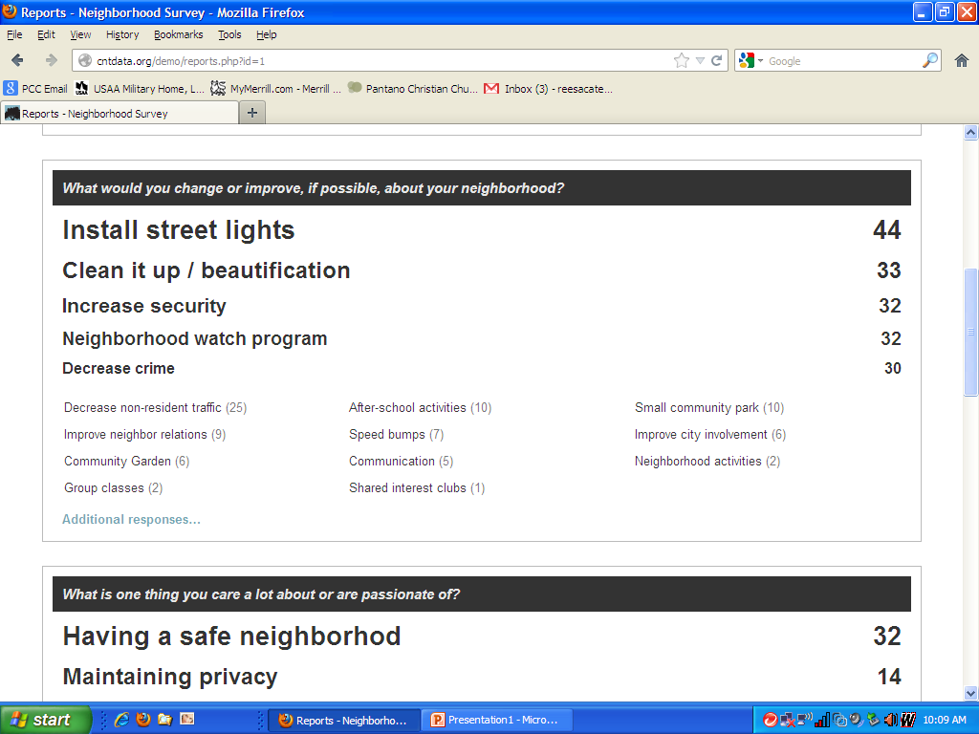

Slide 28
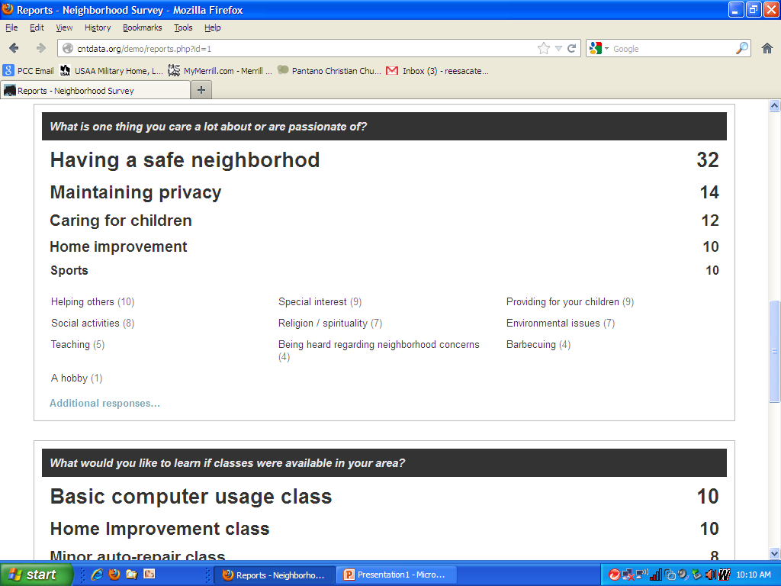

Slide 29
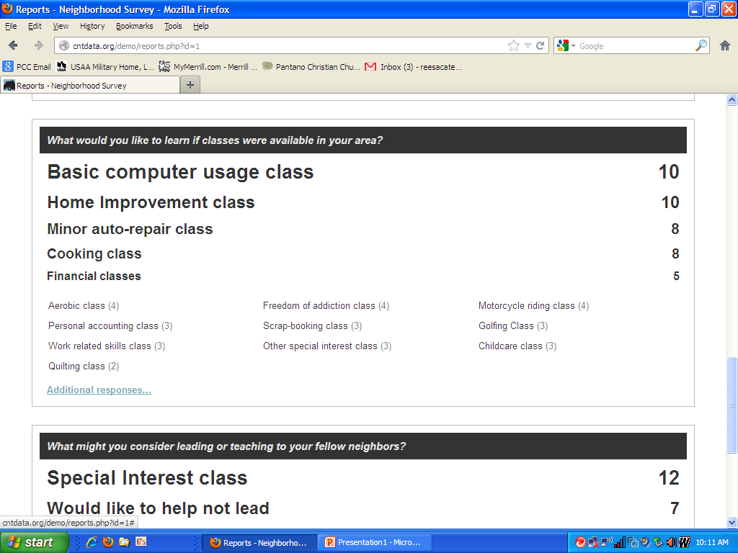

Slide 30
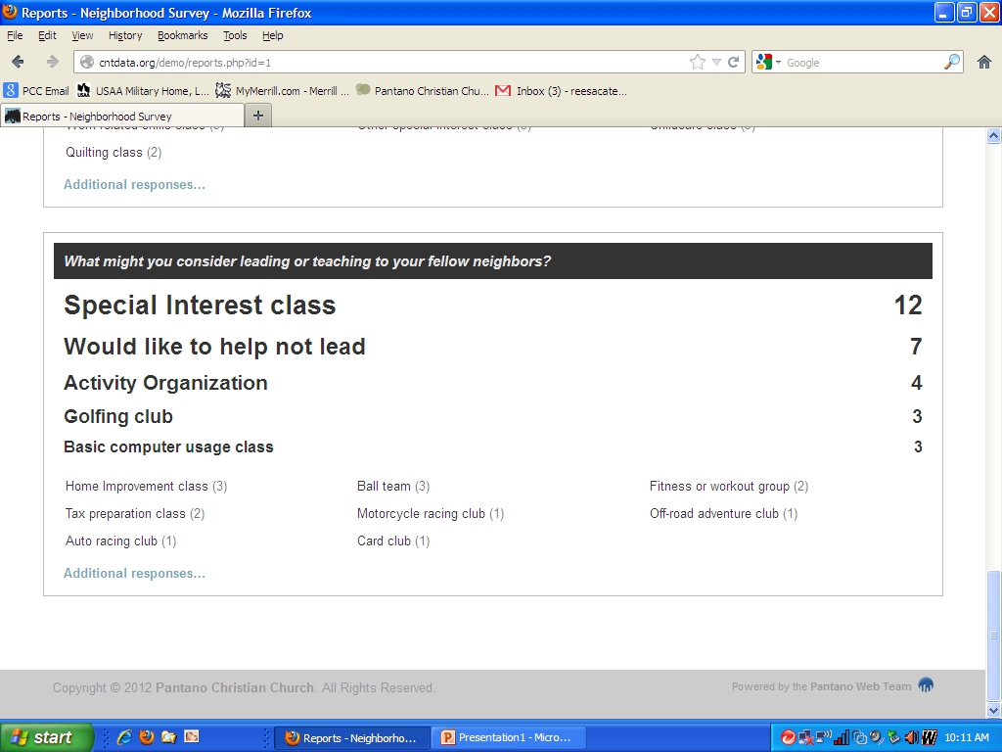

Slide 31
Aligning Assets With Summary Data

Slide 32
Click Download Excel (CSV)

